Slide 1



Text Analysis and Topic Modeling
Vanessa Gómez Verdejo
Jesús Cid Sueiro
ML4DS: Machine Learning 4 Data Science
Universidad Carlos III de Madrid

Slide 2
Contents
Corpus Acquisition
Corpus Processing
Text processing tools:
Natural Language Toolkit (NLTK)
Semantic Analysis
Topic Models: PLSI, LDA

Slide 3
Corpus Acquisition
Corpus Acquisition
Corpus Processing
Text processing tools:
Natural Language Toolkit (NLTK)
Semantic Analysis
Topic Models: PLSI, LDA

Slide 4
Text sources
Any document can be analyzed:
Web content: web pages, twitters, blogs, …
Crawler
Available APIs: wikipedia
Local documents
Available corpus: scikit-learn, NLTK

Slide 5
Loading a corpus
From NLTK (pip install nltk)
import nltk
nltk.download()
Mycorpus = nltk.corpus.gutenberg
text_name = Mycorpus.fileids()[0]
raw = Mycorpus.raw(text_name)
Words = Mycorpus.words(text_name)
Install it now and download book content (it takes a while)

Slide 6
Corpus Processing
Corpus Acquisition
Document Processing
Text processing tools:
Natural Language Toolkit (NLTK)
Semantic Analysis
Topic Models: PLSI, LDA

Slide 7
Single document processing
Document
Tokenization
Removing punctuation
Conversion to lowercase
Stemming and lemmatization
Homogeneization
Cleaning
Stopword elimination
Vectorization
Bag of Words model
Feature vector

Slide 8
Tokenization
Tokenization
From text to words (elements inside a sentence):
Homogeneization
>> Words = corpus.words(text_name)
>> Sentence = “Hola, mundo.”
>> sentence.split()
[‘Hola,’, ‘mundo.’]
>> from nltk.tokenize import word_tokenize
>> word_tokenize(sentence)
[‘Hola’, ‘,’, ‘mundo’, ‘.’]
Cleaning
Vectorization

Slide 9
Homogeneization
Tokenization
EXERCISE 1
Convert every word to lowercase
EXERCISE 2
Remove punctuation
Homogeneization
>> clean_text = [w.lower() for w in text]
Cleaning
>> clean_text = [w for w in text
if w.isalnum()]
Vectorization

Slide 10
Homogeneization
Tokenization
The class string in python:
s.find(t) index of first instance of string t inside s (-1 if not found)
s.rfind(t) index of last instance of string t inside s (-1 if not found)
s.join(text) combine the words of the text into a string using s as the glue
s.split(t) split s into a list wherever a t is found (whitespace by default)
s.lower() a lowercased version of string s
s.upper() an uppercased version of string s
s.title() a titlecased version of string s
s.strip() a copy of s without leading or trailing whitespace
s.replace(t, u) replace instances of t with u inside s
t in s test if t is contained inside s
Homogeneization
Cleaning
Vectorization

Slide 11
Homogeneization
Tokenization
Stemming
We count similar words in different variants as different words
We need a function that reduces words to their specific word stem.
Homogeneization
Cleaning
import nltk.stem
s = nltk.stem.SnowballStemmer('english')
s.stem(“imaging”) # → u'imag'
s.stem(“image") # → u'imag’
Vectorization

Slide 12
Homogeneization
Tokenization
N-grams
Some words tend to occur in groups
information processing, machine learning…
It can be useful that they are analyzed in groups
There are routines to detect them, but the easiest way is…
informationprocessing
machinelearning
Homogeneization
Cleaning
Vectorization

Slide 13
Cleaning
Tokenization
Removing least relevant words
Some words appear very often in all sorts of different contexts.
They are so frequent that they do not help to distinguish between different texts.
These words are called stop words.
The best option would be to remove them
Homogeneization
Cleaning
Vectorization

Slide 14
Cleaning
Tokenization
Removing stopwords:
from nltk.corpus import stopwords
sw = stopwords.words('english')
clean_text = [word for word in document
if not word in sw]
Homogeneization
Cleaning
Vectorization

Slide 15
Parallel Document Processing
Tokenization
Until now, we have worked with a single document
Extend your code to work with all the documents of the corpus
Create a list of text, where each row is a previously processed text
content = [
[u'fulton', u'counti', u’grand', …, u'said', u’friday’]
[u’austin', u’texa', u’committe', …, u’price', u’abandon’]
….
[u’dear', u’sir', u’let', u’begin', …, u’mind', u’address’]
]
Homogeneization
Cleaning
Vectorization

Slide 16
Parallel Document Processing
Tokenization
content = []
for text_name in corpus.fileids():
path = nltk.data.find(
'corpora/brown/'+text_name)
f = open(path, 'rU')
raw = f.read()
# Here you can process your
# raw text → clean_text
content.append(clean_text)
f.close()
Homogeneization
Cleaning
Vectorization

Slide 17
Vectorization
Tokenization
Bag of words: counting words
ML algorithms process numbers, not words.
Only if we manage to transform text into meaningful numbers, we can feed it into ML algorithms
Bag-of-word approach: for each word in the document, count its occurrence and note it in a vector
Homogeneization
Cleaning
Vectorization

Slide 18
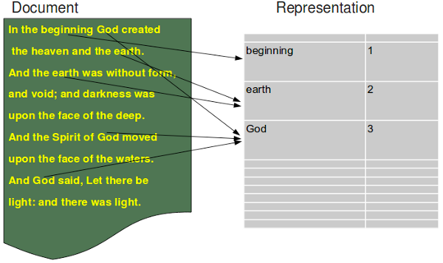
Vectorization
Tokenization
Bag of words: counting words
Homogeneization
Cleaning
Vectorization

Slide 19
Vectorization
Tokenization
Term frequency - Inverse document frequency (TF-IDF)
BoW: the feature values simply count occurrences of terms in a document.
High occurrence terms?? They appear in all documents → NON RELEVANT.
Low occurrence terms?? They appear in very few documents → RELEVANT
This can only be solved by:
counting term frequencies for each document
discounting those that appear in many posts
Homogeneization
Cleaning
Vectorization

Slide 20
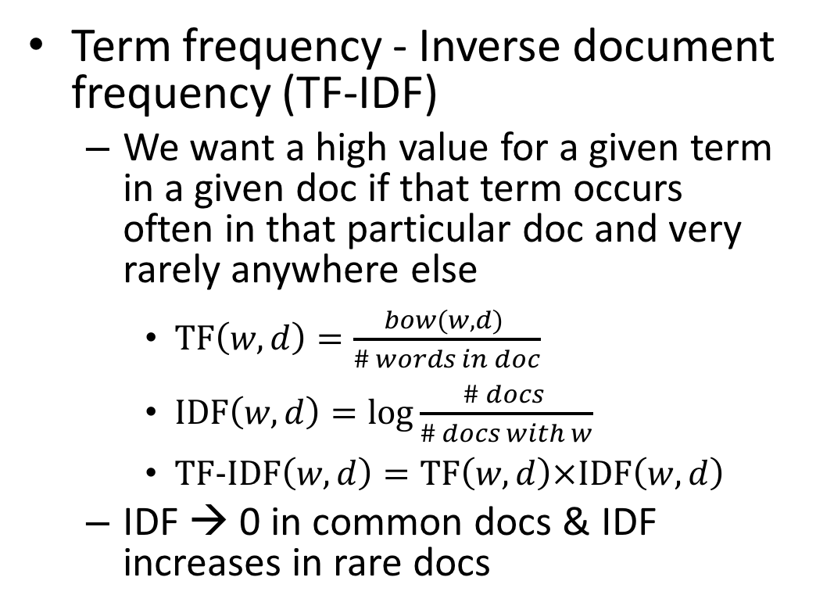
Vectorization
Tokenization
Term frequency - Inverse document frequency (TF-IDF)
We want a high value for a given term in a given doc if that term occurs often in that particular doc and very rarely anywhere else
$\text{TF}\left(w,d\right)=\frac{bow(w,d) }{\# words in doc}$
$\text{I}\text{D}\text{F}\left(w,d\right)=\log{\frac{\# docs }{\# docs with w}}$
$\text{TF}\text{−}\text{IDF}\left(w,d\right)=\text{TF}\left(w,d\right)×\text{ID}\text{F}\left(w,d\right)$
IDF → 0 in common docs & IDF increases in rare docs
Homogeneization
Cleaning
Vectorization

Slide 21
Semantic Analysis
Corpus Acquisition
Corpus Processing
Text processing tools:
Natural Language Toolkit (NLTK)
Semantic Analysis
Topic Models: PLSI, LDA

Slide 22
Topic models
Topic Models attempt to uncover the underlying semantic structure of a document corpus by identifying recurring patterns of terms (topics).
Topic models
do not parse sentences
do not care about word order, and
do not “understand” grammar or syntax
Topic models are useful on their own to build visualizations and explore data. They are also very useful as an intermediate step in many other tasks.

Slide 23
Topic modelling tools
Gensim
Developed by Radim Řehůřek.
Topics and transformations: Gensim includes
BOW
TF-IDF
Latent Semantic Indexing, LSA/LSI
Latent Dirichlet Allocation, LDA

Slide 24
Gensim
Instalation:
Data Structures
Corpus: list of documents
Document: list of words
pip install gensim
easy_install gensim

Slide 25
Working with Gensim
Import tools.
Represent the words by ids (integer) → create a dictionary
Vectorize the documents: create bow.
Gensim has efficient implementations for long corpus (work document to document): http://radimrehurek.com/gensim/tut1.html
from gensim import corpora
D = corpora.Dictionary(docs)
bow = [D.doc2bow(doc) for doc in docs]

Slide 26
Working with Gensim
Compute tf-idf values.
From now on, tfidf can be used to convert any vector from the old representation (bow integer counts) to the new one (TfIdf real-valued weights):
Or to apply a transformation to a whole corpus:
from gensim import models
# 1-- initialize a model
tfidf = models.TfidfModel(corpus_bow)
doc_bow = [(0, 1), (1, 1)]
# 2-- transform a new vector
tfidf[doc_bow]
corpus_tfidf = tfidf[corpus_bow]

Slide 27
Latent Semantic Analysis/Indexing
It transforms documents from either bag-of-words or (preferably) TfIdf-weighted space into a latent space of a lower dimensionality.
LSI or LSA is able to correlate semantically related terms that are latent in a collection of text
LSI uses example documents to establish the conceptual basis for each category.
LSI overcomes two of the most problematic constraints of Boolean keyword queries: multiple words that have similar meanings (synonymy) and words that have more than one meaning (polysemy).

Slide 28
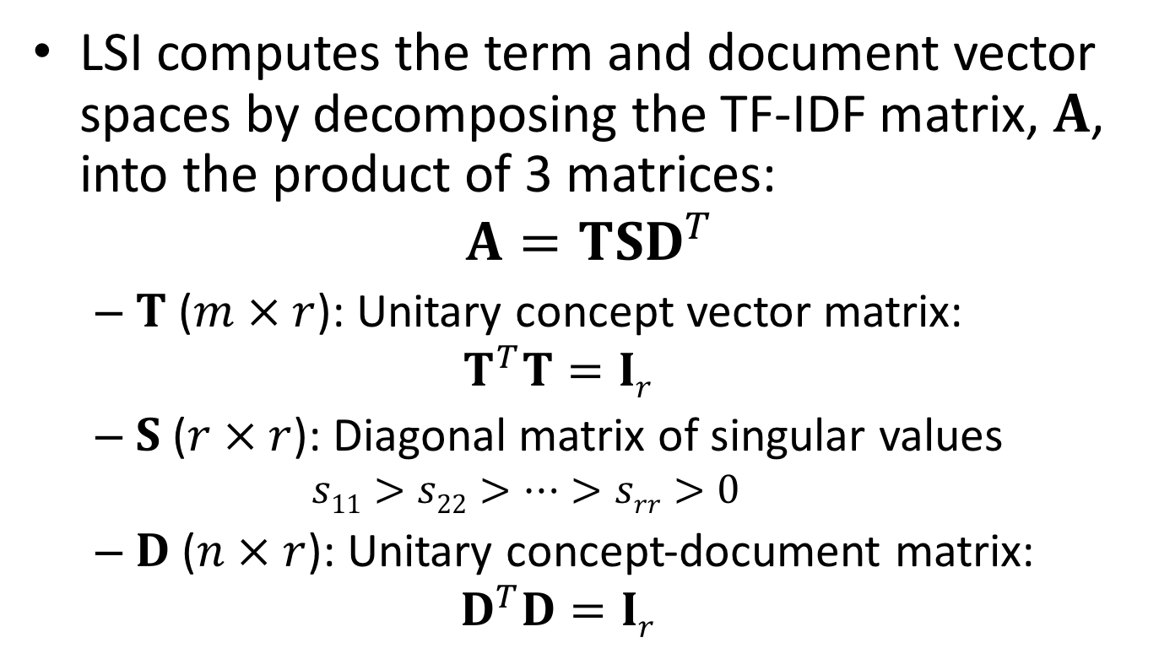
Latent Semantic Analysis/Indexing
LSI computes the term and document vector spaces by decomposing the TF-IDF matrix, $A$, into the product of 3 matrices:
$$A=TSD^{T}$$
$T$ ($m × r$): Unitary concept vector matrix:
$$T^{T}T=Ir$$
$S$ ($r × r$): Diagonal matrix of singular values
$$s11>s22>…>srr>0$$
$D$ ($n × r$): Unitary concept-document matrix:
$$D^{T}D=Ir$$

Slide 29
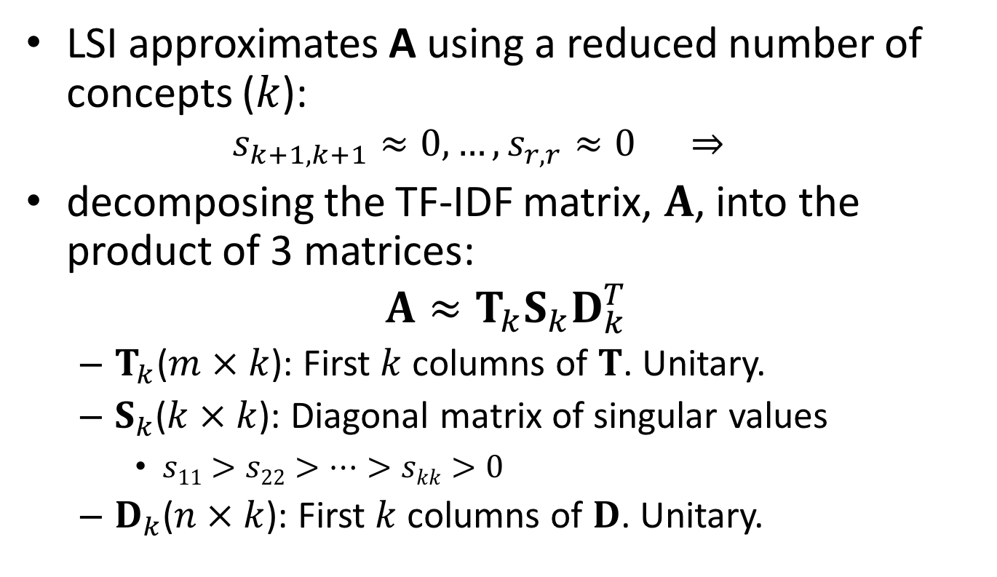
Latent Semantic Analysis/Indexing
LSI approximates A using a reduced number of concepts ($k$):
$$s_{k+1,k+1}≈0, …,s_{r,r}≈0 ⇒$$
decomposing the TF-IDF matrix, $A$, into the product of 3 matrices:
$$A≈T_{k}S_{k}D_{k}^{T}$$
$T_{k}$($m × k$): First $k$ columns of $T$. Unitary.
$S_{k}$($k × k$): Diagonal matrix of singular values
$s11>s22>…>skk>0$
$D_{k}$($n × k$): First $k$ columns of $D$. Unitary.

Slide 30
LSA-LSI
Steps to transform our Tf-Idf corpus via LSI into a latent 2-D space
It allows incremental updates:
# Initialize an LSI transformation
lsi = models.LsiModel(corpus_tfidf,
id2word=dictionary, num_topics=2)
# On real corpora, target dimensionality of
# 200–500 is recommended as a “golden standard”
# Create a double wrapper over the original
# corpus bow → tfidf → fold-in-lsi
corpus_lsi = lsi[corpus_tfidf]
lsi.add_documents(another_tfidf_corpus)

Slide 31
LSA-LSI
Analyzing the topics:
“trees”, “graph” and “minors” are all related words (and contribute the most to the direction of the first topic)
>> # both bow->tfidf and tfidf->lsi transformations are actually executed here, on the fly
>> lsi.print_topics(2)
topic #0(1.594): -0.703*"trees" + -0.538*"graph" + -0.402*"minors" +…
topic #1(1.476): -0.460*"system" + -0.373*"user" + -0.332*"eps" +….

Slide 32
LSA-LSI
Analyzing document representation over the topics:
>> for doc in corpus_lsi:
print(doc)
# "The intersection graph of paths in trees"
[(0, -0.877), (1, -0.168)]
# "System and human system engineering testing of
# EPS”
[(0, -0.076), (1, 0.632)]

Slide 33
Latent Dirichlet Allocation (LDA)
LDS is another transformation from bag-of-words counts into a topic space of lower dimensionality.
LDA is a probabilistic extension of LSA, so LDA’s topics can be interpreted as probability distributions over words.
These distributions are inferred automatically from a training corpus.
Documents are in turn interpreted as a (soft) mixture of these topics (again, just like LSA).

Slide 34
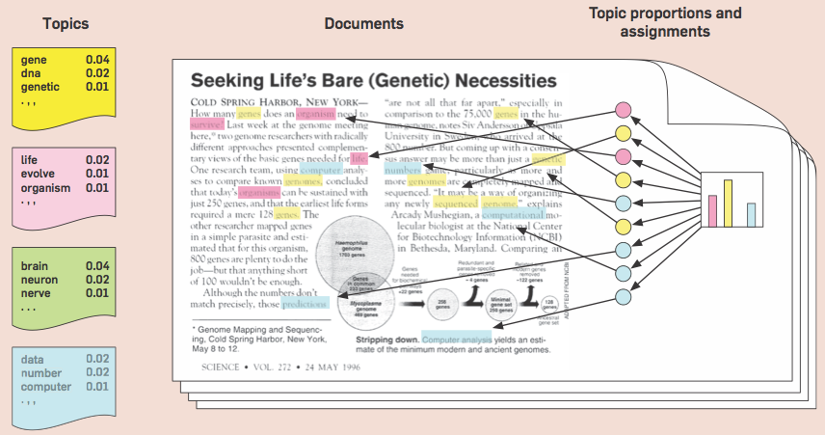
Latent Dirichlet Allocation

Slide 35
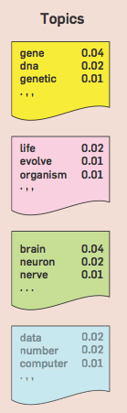
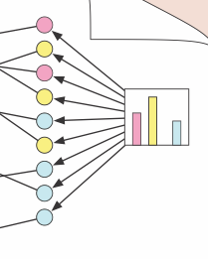

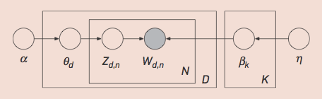


LDA
LDA is a generative probabilistic model:
GOAL → inferring the topic structure (hidden variables) from the words of documents (observed variables)
Topic distribution
over the vocabulary
Topic proportions of d-th document
Topic assignment of n-th word in document d-th

Slide 36



LDA
The generative process for LDA corresponds to the following joint distribution of the hidden and observed variables
Goal: computing the conditional distribution of the topic structure given the observed documents

Slide 37
LDA
The denominator is the probability of seeing the observed corpus under any topic model.
It can be computed by summing the joint distribution over every possible hidden topic structure.
The number of possible topic structures is exponentially large; this sum is intractable to compute.
Two LDA families
Sampling-based algorithms
Variational algorithms

Slide 38
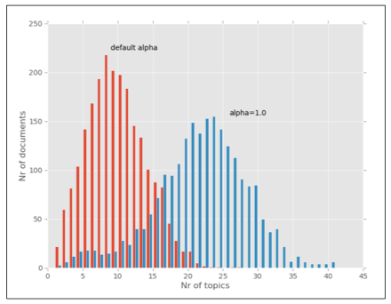
LDA in Gensim
Steps:
# Create an LDA transformation
lda = gensim.models.LdaModel(corpus_bow,
id2word=dictionary, alpha='auto', num_topics=20)
It automatically updates the alpha value
Bigger values for alpha will result in more topics per document

Slide 39
LDA in Gensim
>> # Analize topics
>> # (the top 5 words associated with 5 topics)
>> lda.print_topics(topics=5, topn=5)
['0.047*link + 0.027*ui + 0.018*main + 0.017*level + 0.016*locale',
'0.107*tap + 0.047*popup + 0.045*appears + 0.031*request + 0.029*tab',
'0.120*play + 0.096*ics + 0.084*music + 0.049*bug + 0.030*android',
'0.106*device + 0.078*google + 0.060*talk + 0.057*voice + 0.044*icon’,
'0.191*screen + 0.055*button + 0.034*change + 0.032*page + 0.032*lock’]
Weights indicate the relevance of a word for a given topic

Slide 40
LDA in Gensim
More things to do….
# training document representation
for doc in lda:
print(doc)
# get topic probability distribution for a document
print(lda[doc_bow])
# update the LDA model with additional documents
lda.update(corpus2)
print(lda[doc_bow])

